Slide 1
Alumni API
Capstone Project – Team Samurai

Slide 2
Introduction:
Team Members
Roles and Responsibilities
Expectations

Slide 3
Client Problem
Our Client (Latrus Inc) HR department needs a software solution to provide documents to their alumni​
HR department gets frequent requests from their Alumni about documents stored on Company’s AWS environment​
HR downloads these documents and send them as attachments via mail (Tedious Work, Time Consuming, No proper records)

Slide 4
Project Solution
Create an application programming interface (API) that will have the following functionalities
Registration module allowing past employees to self register via verification email
Registered past employees can download their own documents
Log all account activities every time someone logs in and downloads
* API - is a set of definitions and protocols for building and integrating application software

Slide 5
Additional Deliverables
Containerize the solution
Deploy to Cloud

Slide 6



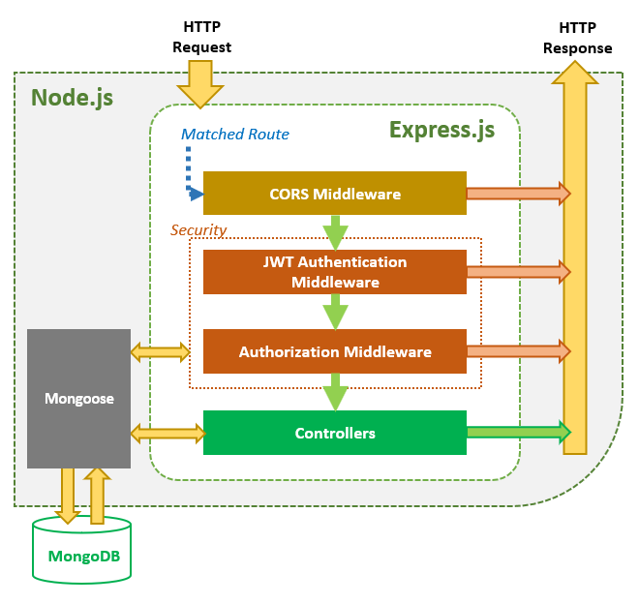
Our Technical Approach

Slide 7
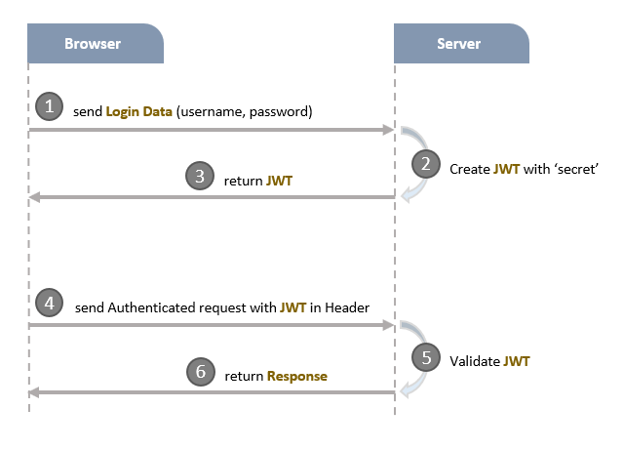
Authentication

Slide 8
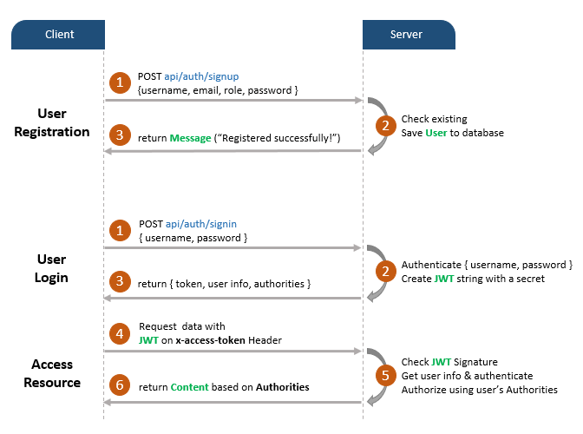
Authentication

Slide 9
Business Outcomes
HR Department working hours decreased
For searching and sending documents
Repetitive work
Less manual work such as phone calls and complaints
Employees :
Immediate access to documents
Extended level of security, as less number of people access and work with their sensitive documents

Slide 10
Benefits for safety
Because safety is the same important, as accessibility, the Alumni Portal will protect:
Impact of the changes in other company’s software
Risks of revealing information when copied, scanned or sent via email

Slide 11
Stakeholder Benefits:
Because of the automatization, it is planned stakeholders following advantages:
Decrease of salaries, paid for managing documents. Because employees can visit Alumni Portal and register, find and download all the documents automatically, HR personnel will not be required do this job manually, so stakeholders can give them other tasks to do;
Decrease salaries, paid for the managing documents of those employees, who coming back to the company, after the work in other companies. So HR managers will not be required to create new profiles, scan documents. Just check if the profile matches with the documents.
HR personnel and other employees, including former employees will have access any date and time, exclude the repetitive work.

